Slide 1

Open EDR
Presented by
1705086, 1705087,
1705088, 1705089,
1705090, 1605051

Slide 2

Introduction
An Open Source Initiative started by Comodo
Open source cybersecurity platform where products and services can be managed and provisioned together
Full blown EDR capability
EDR : Endpoint Detection and Response

Slide 3
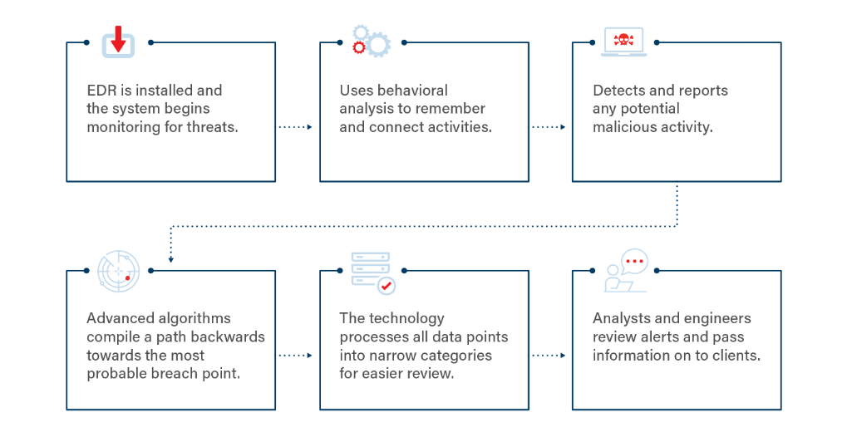
How EDR works?

Slide 4
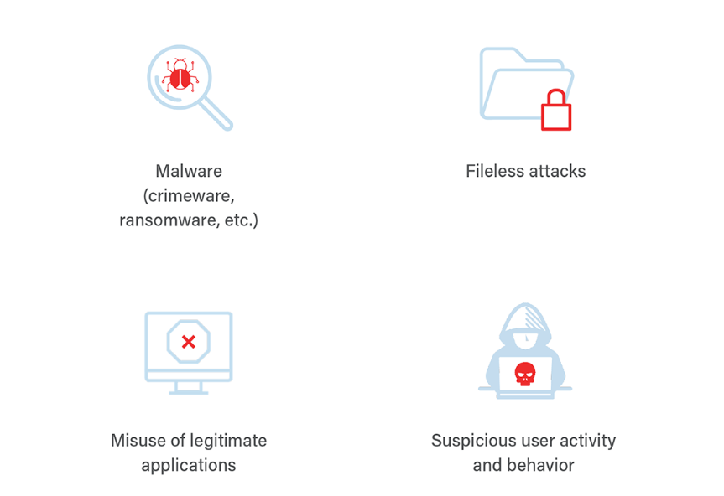
Types of Detected Attacks

Slide 5
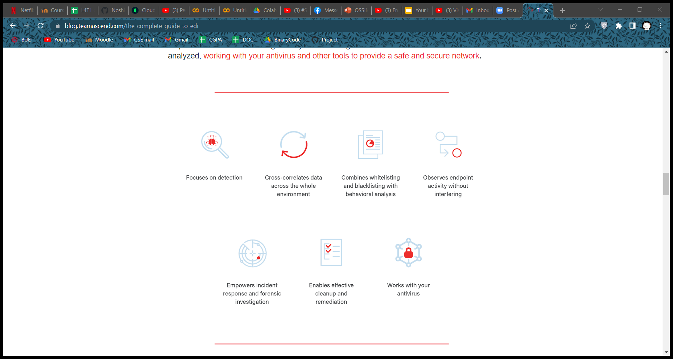
Elements of EDR

Slide 6
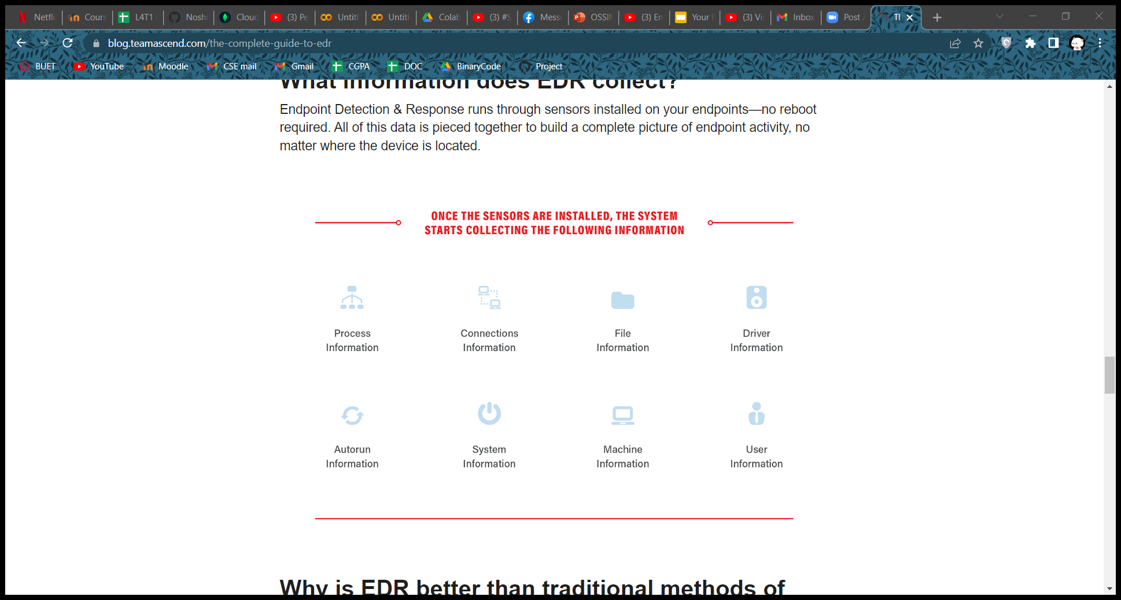
Information Collected by EDR

Slide 7
Open EDR : Features
Guided investigation
Threat intelligence feed integration
Custom rule creation
Device discovery and control

Slide 8
Open EDR : Components
Components
Core Library
Process Monitor
System Monitor
Services
Monitors
Network Monitor

Slide 9
Open EDR : Components
Process Monitor
Injected dll
Loader for Injected dll
Controller for Injected dll

Slide 10
Open EDR : Uses
Identify threat patterns
Create alerts
Generate reports

Slide 11




Setup Process

Slide 12
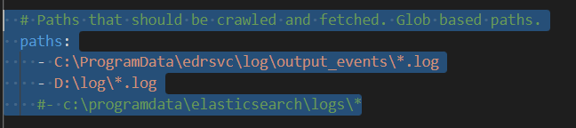
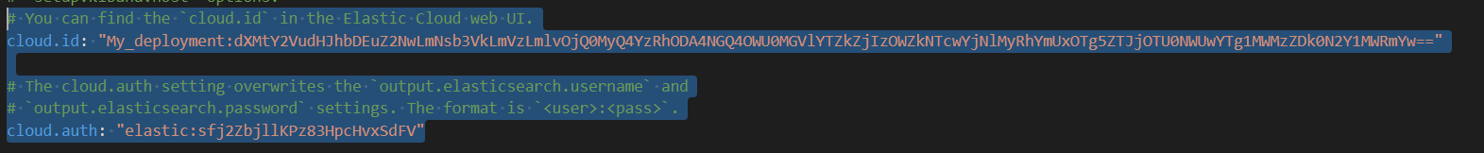
Setup Process (cont.)

Slide 13
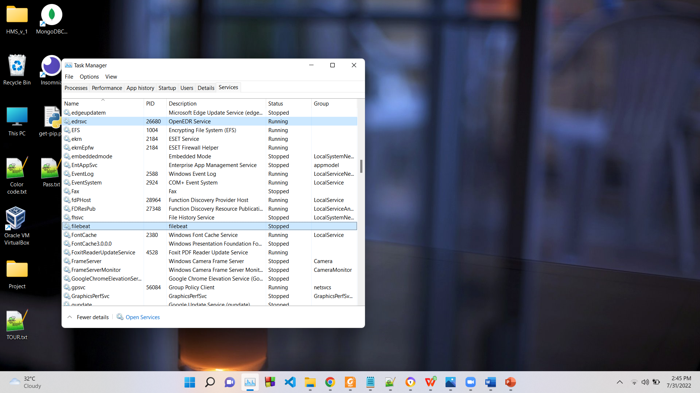
Setup Process (cont.)

Slide 14
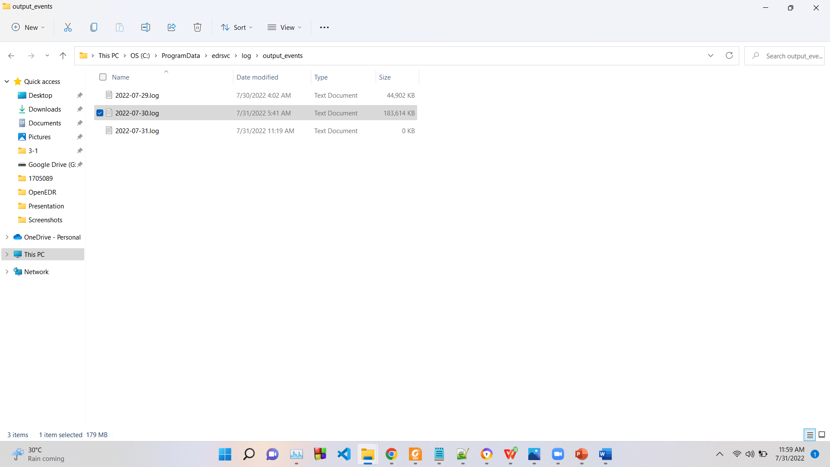
Log File Generation

Slide 15
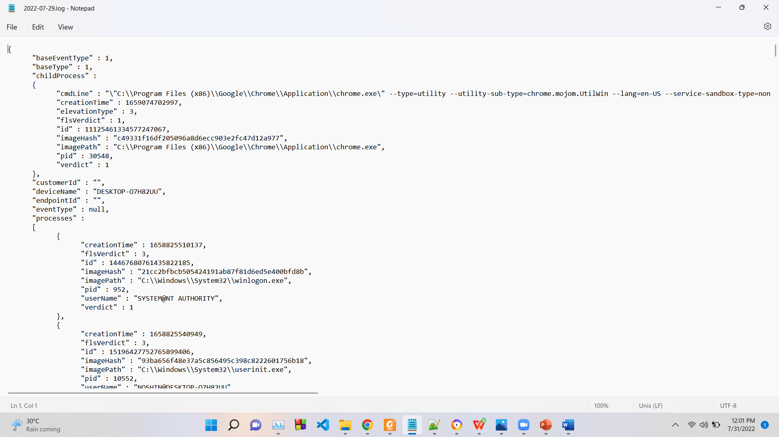
Log File Generation (cont.)

Slide 16
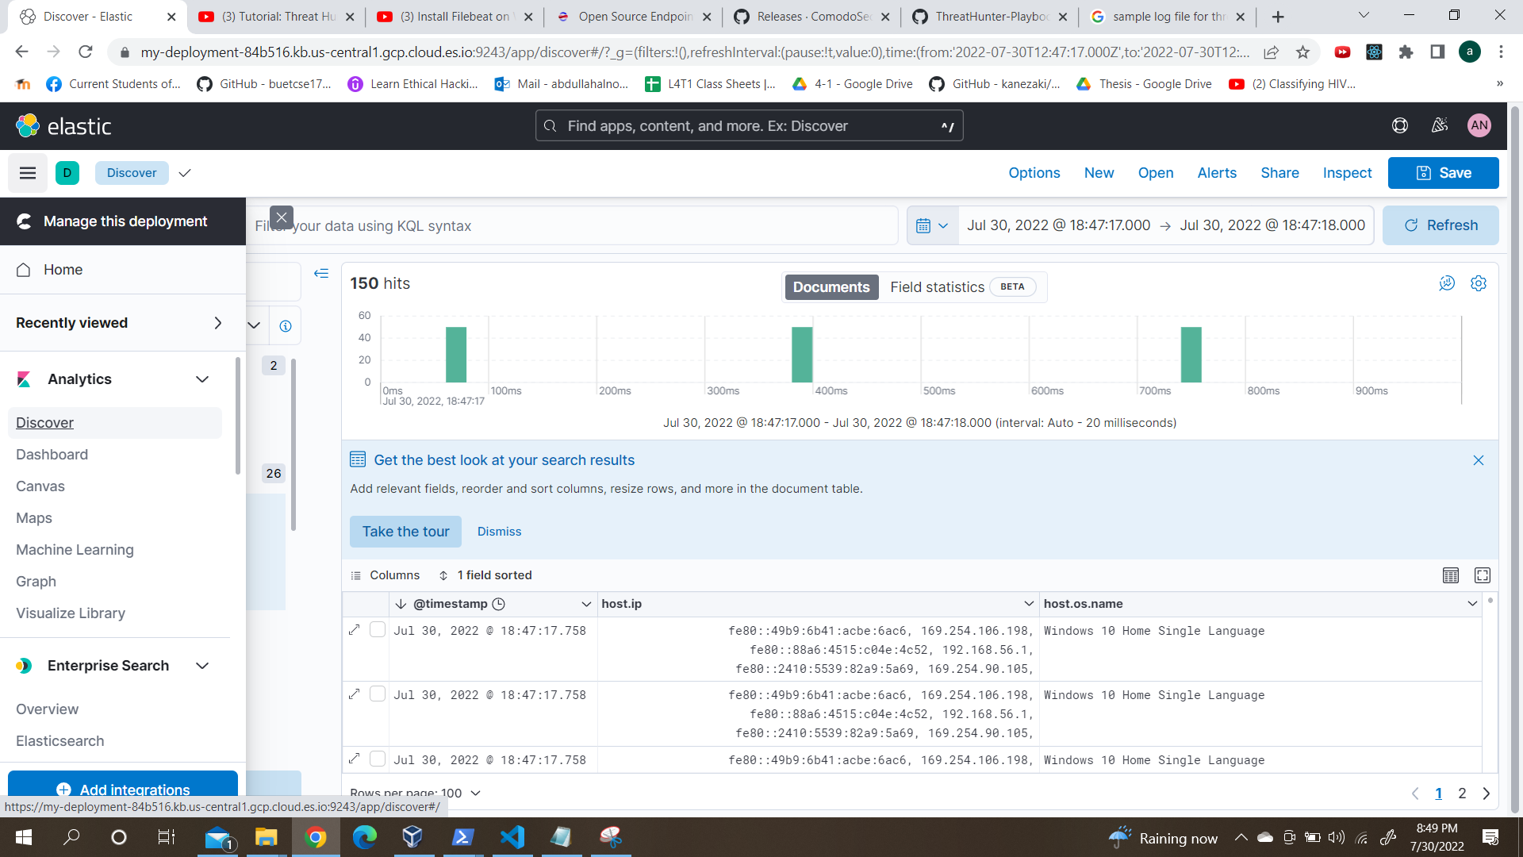
Open EDR Visualization

Slide 17
Open EDR Visualization : Time Filter

Slide 18
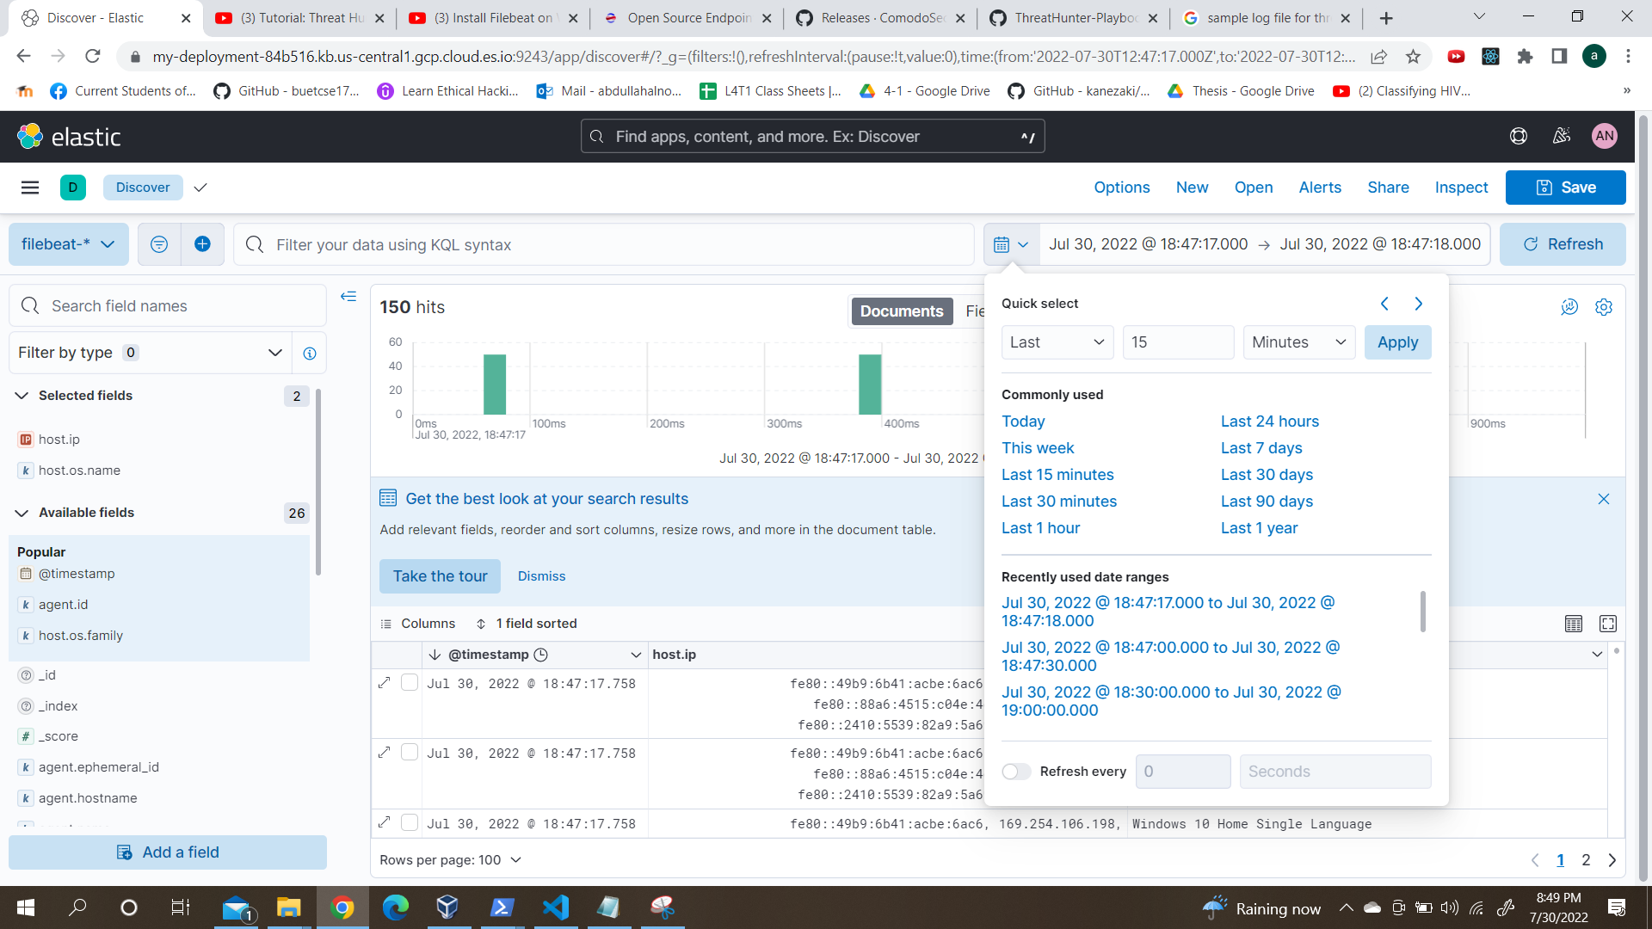
Open EDR Visualization : Time Filter

Slide 19
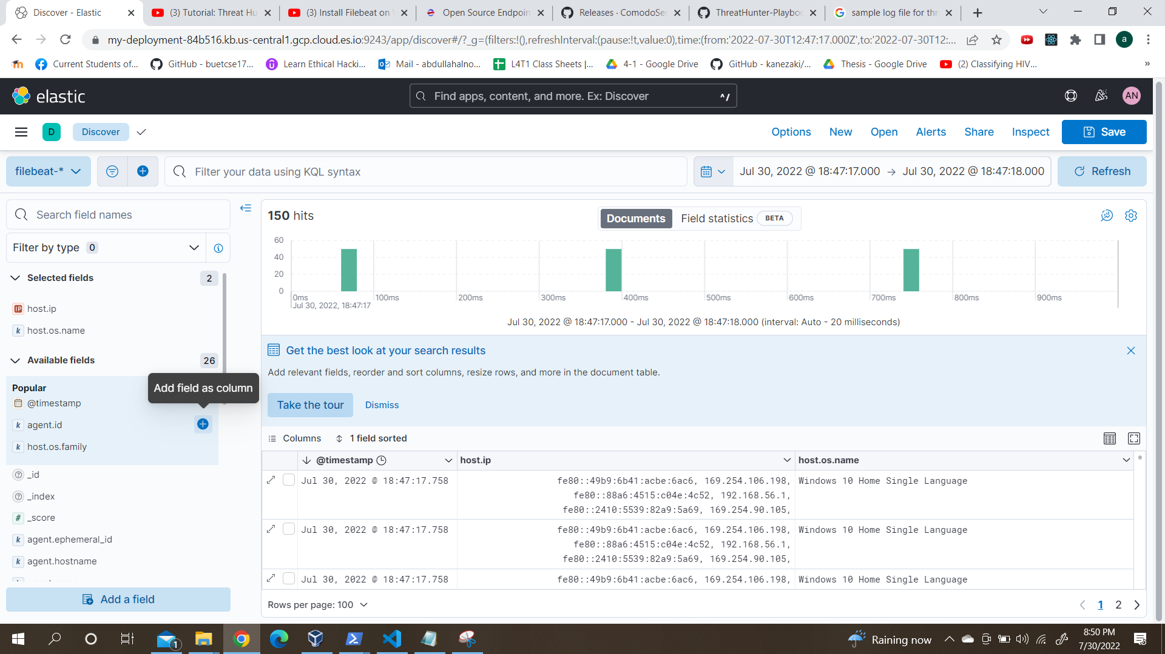
Open EDR Visualization : Column Add

Slide 20
Open EDR Visualization : Column Add

Slide 21
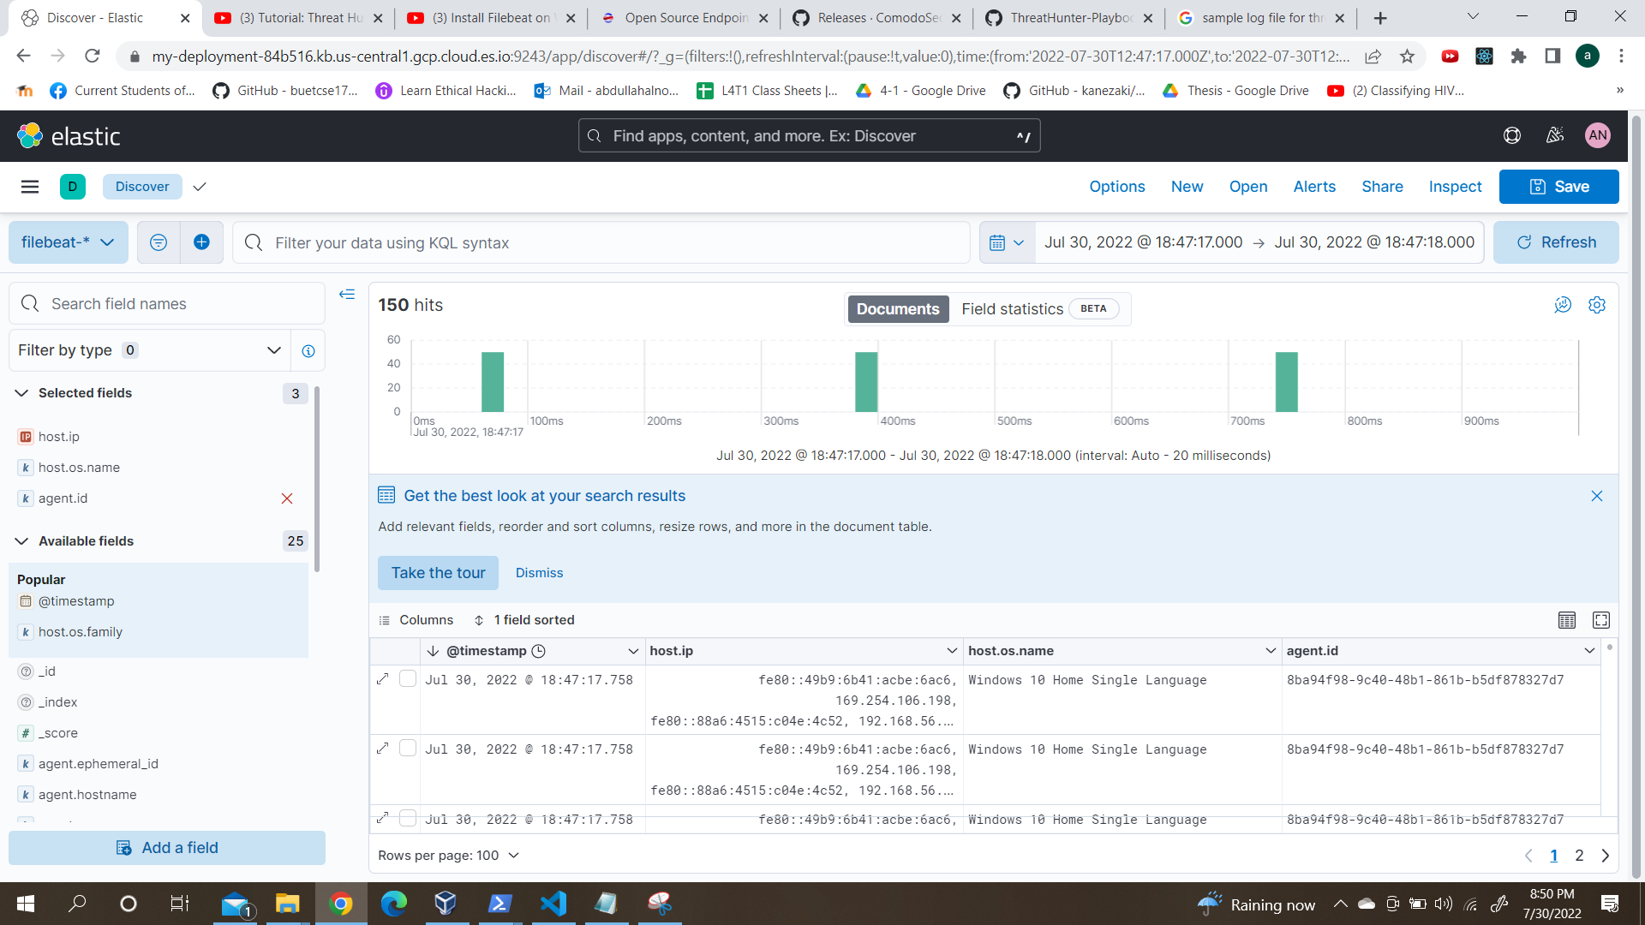
Open EDR Visualization : Column Add

Slide 22
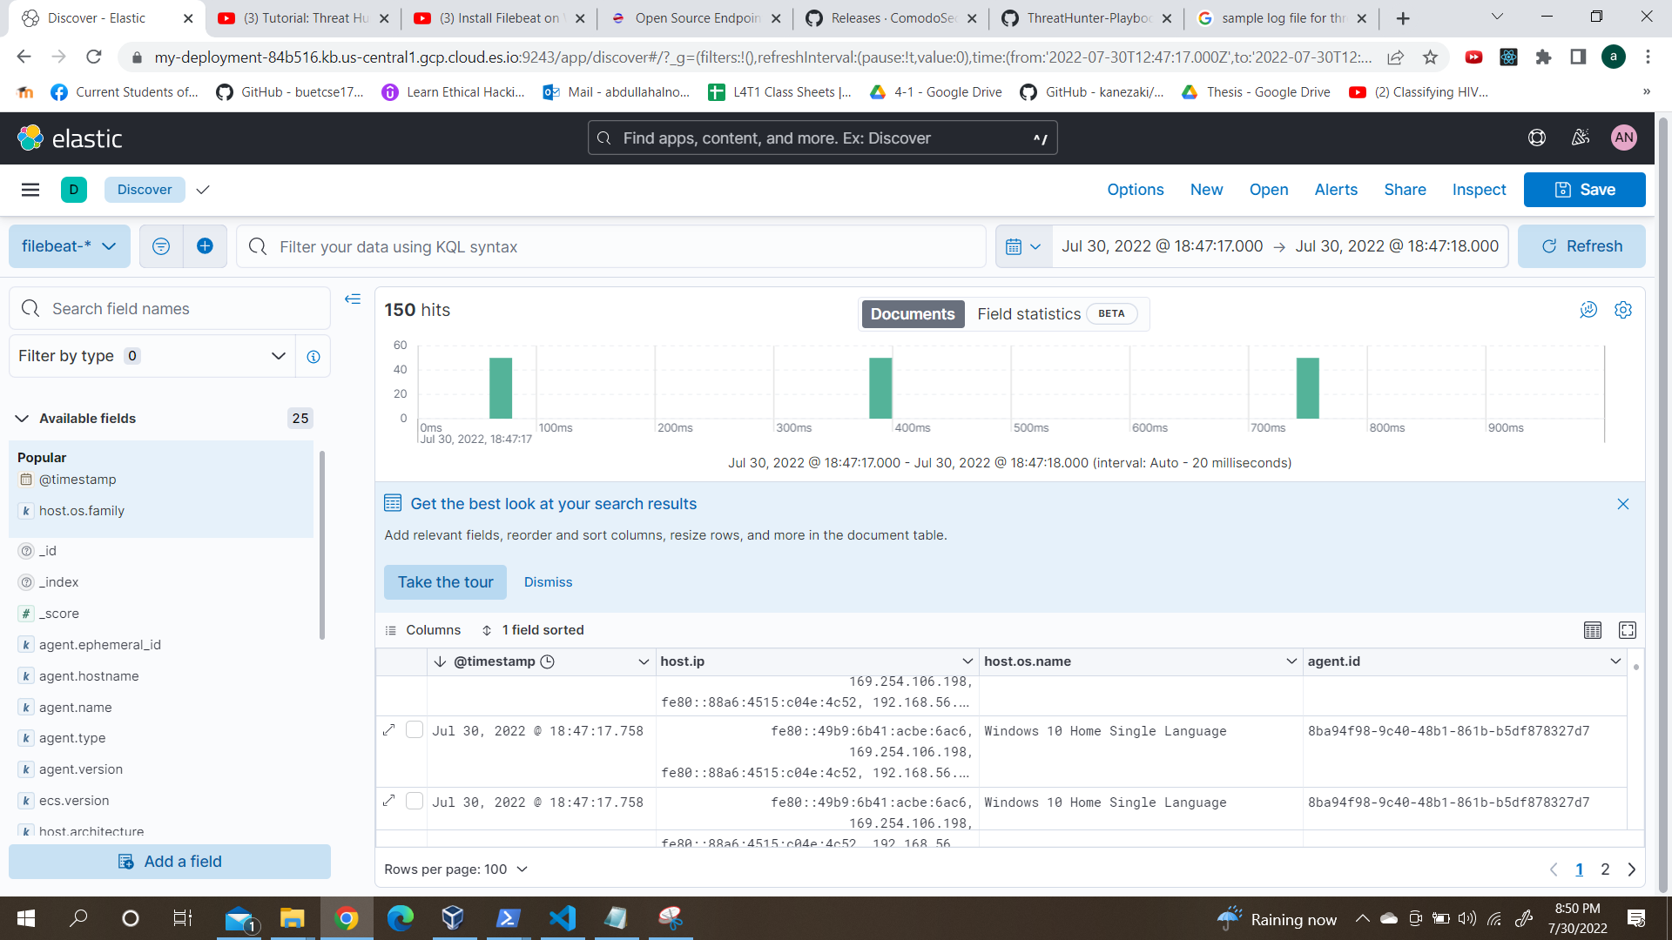
Open EDR Visualization : Column Add

Slide 23
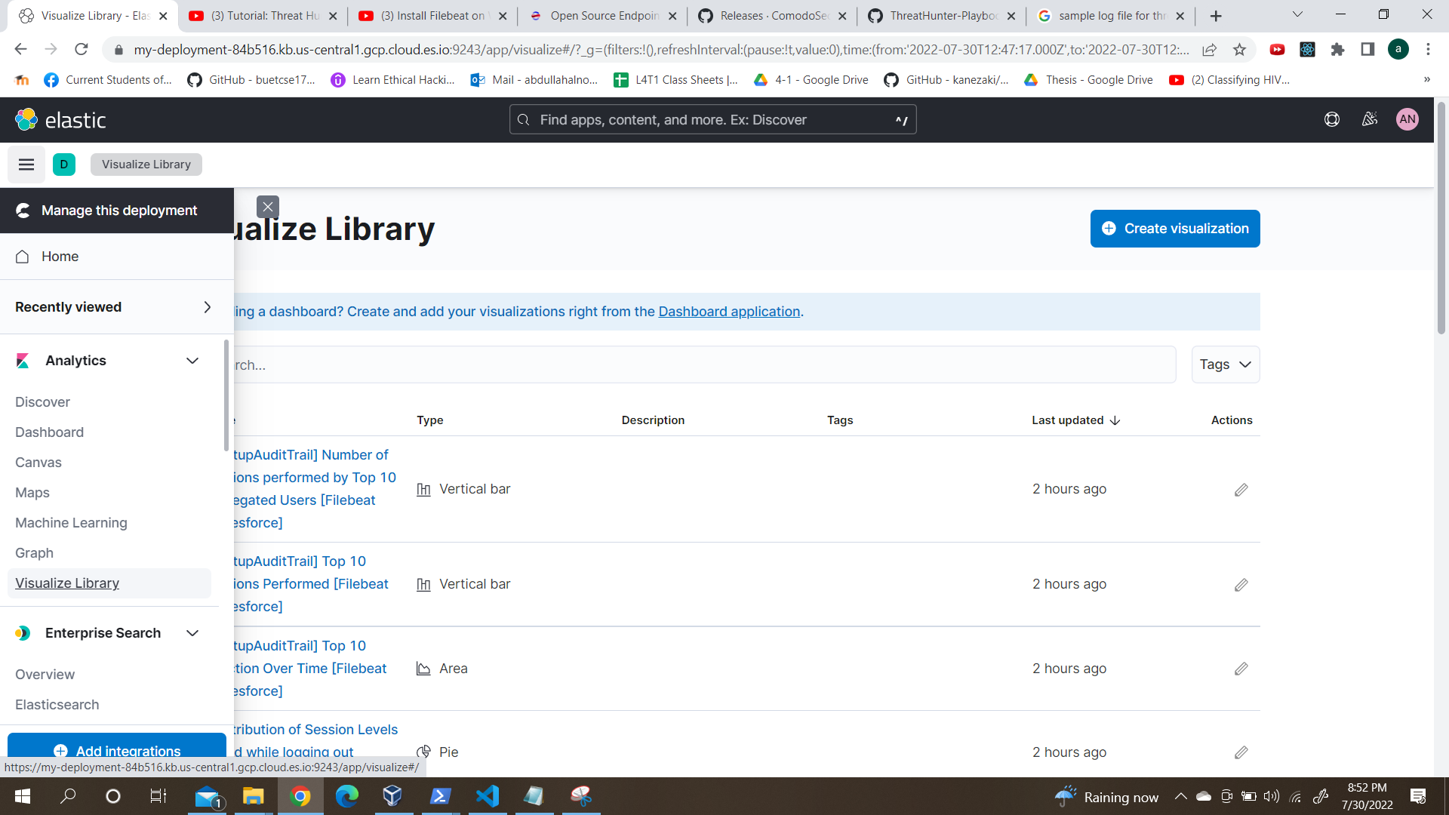
Open EDR Visualization : Visualize Library

Slide 24
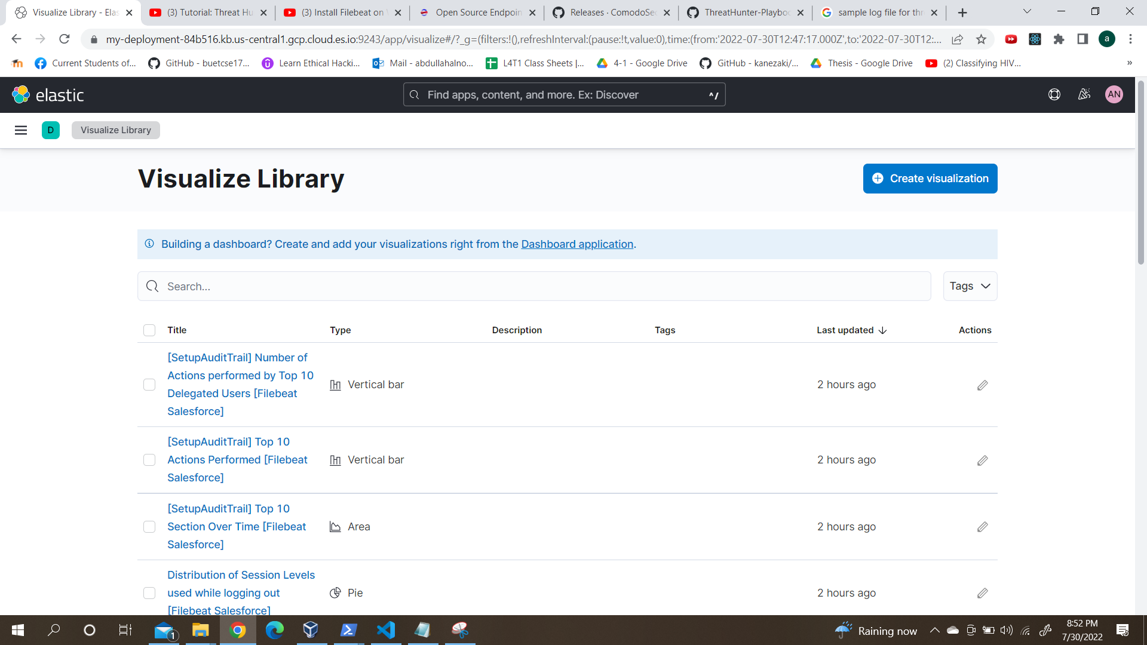
Open EDR Visualization : Visualize Library

Slide 25
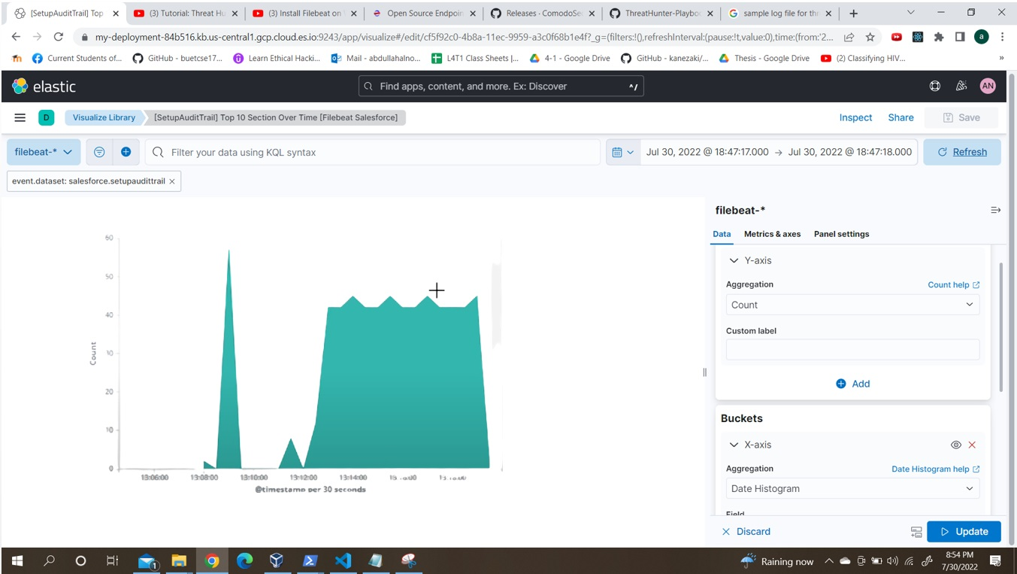
Open EDR Visualization : Visualize Area

Slide 26
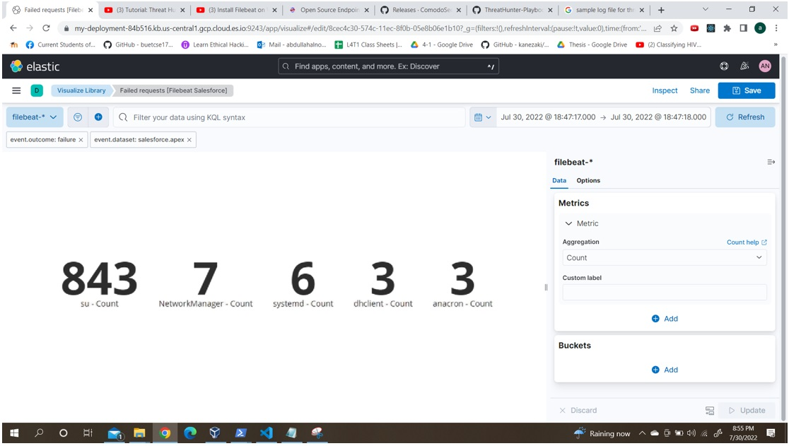
Open EDR Visualization : Visualize Metric

Slide 27
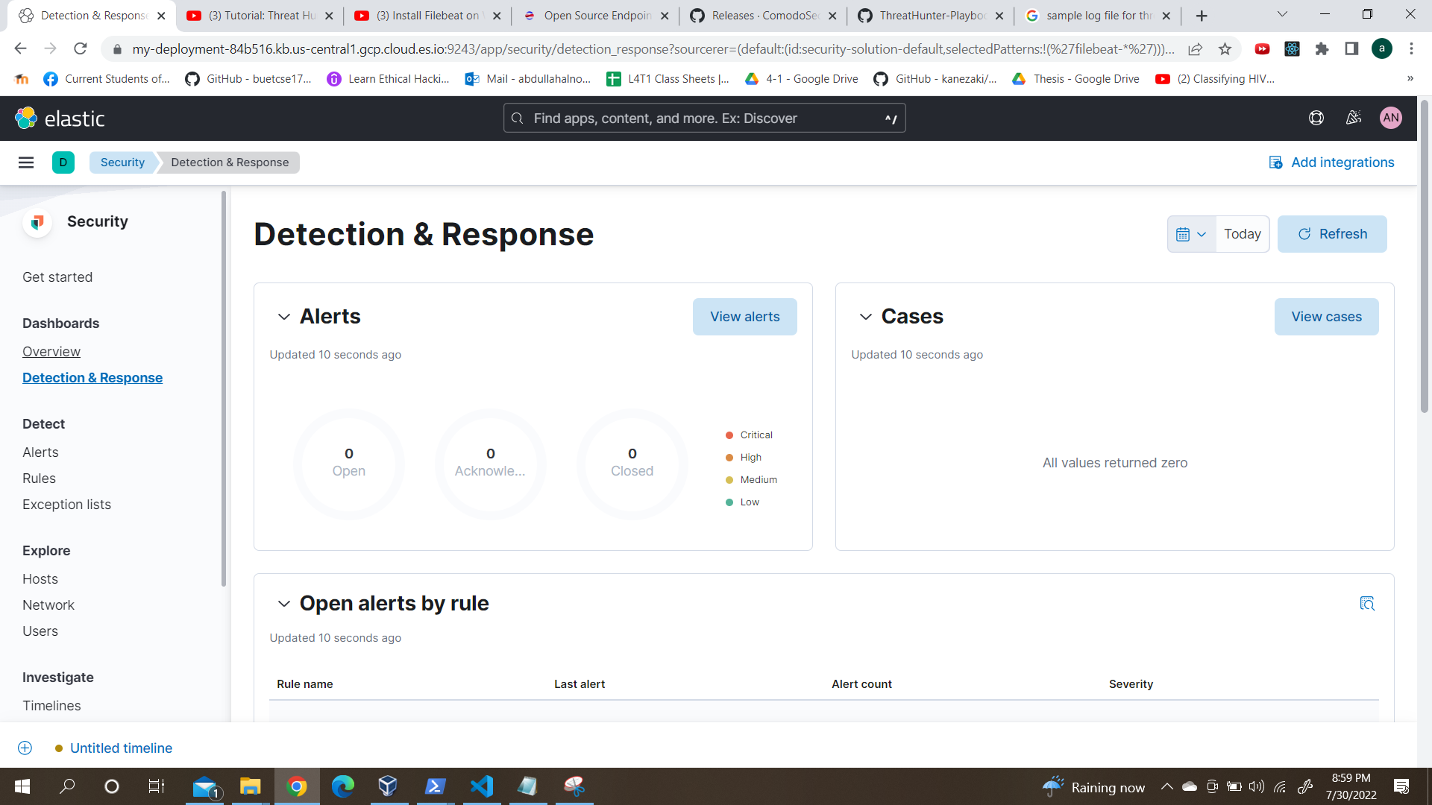
Open EDR Visualization : Detection

Slide 28
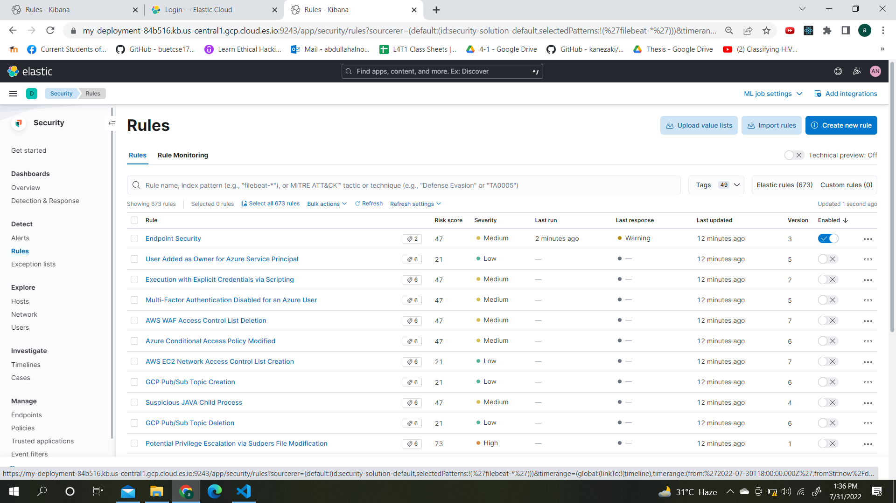
Open EDR Visualization : Rules

Slide 29
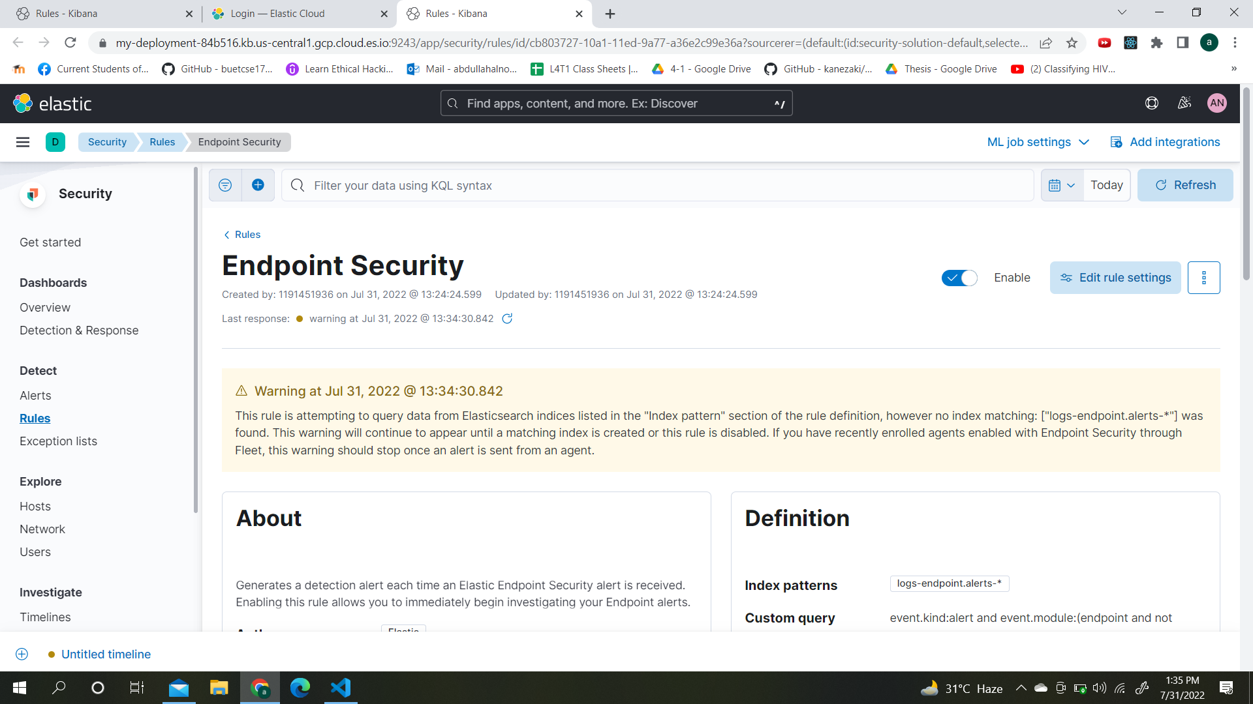
Open EDR Visualization : Rules (cont.)

Slide 30
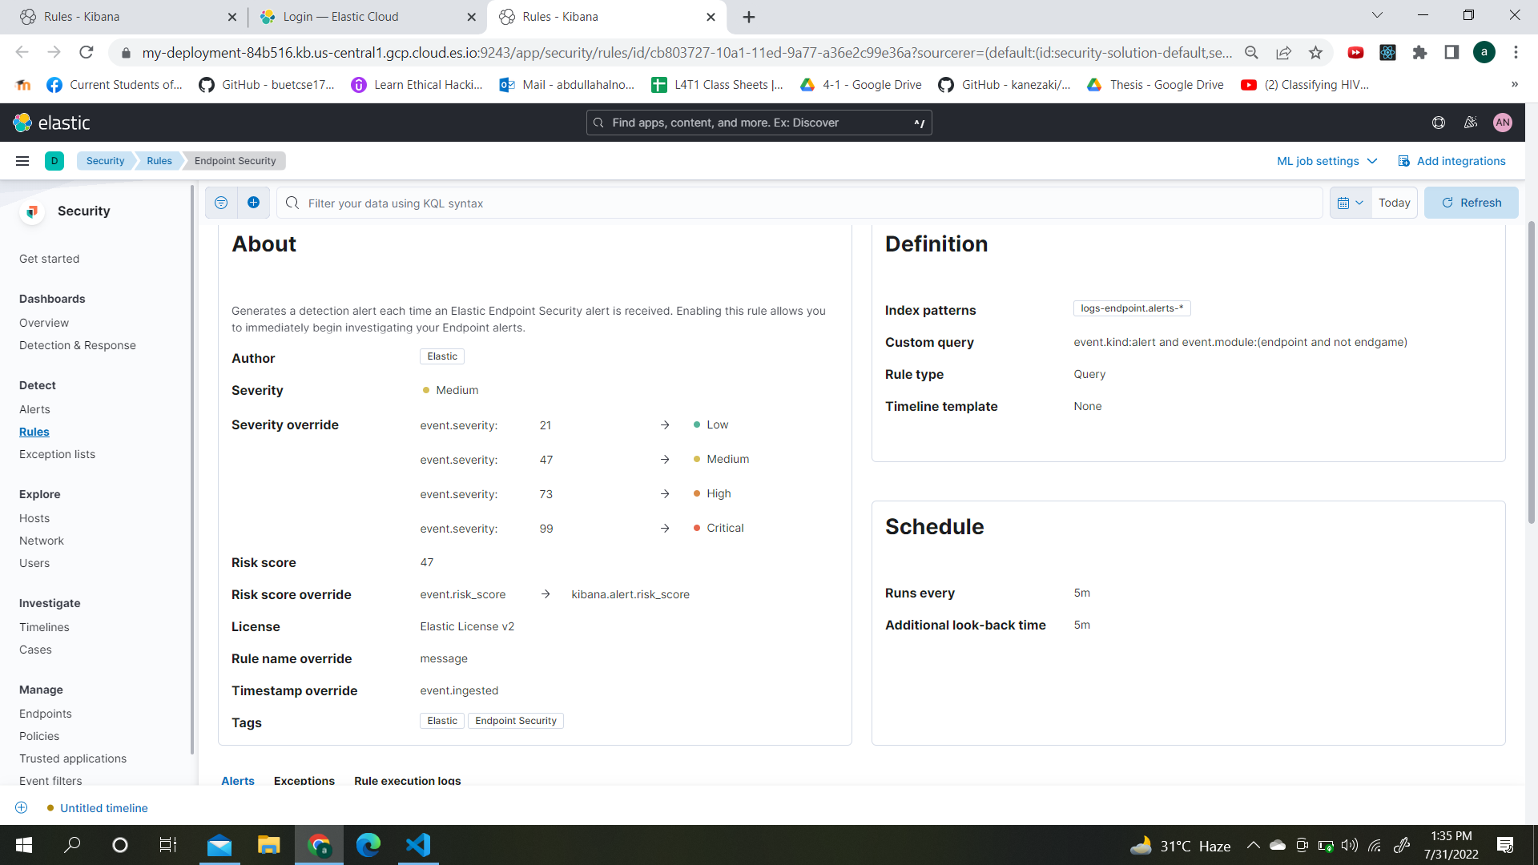
Open EDR Visualization : Rules (cont.)

Slide 31
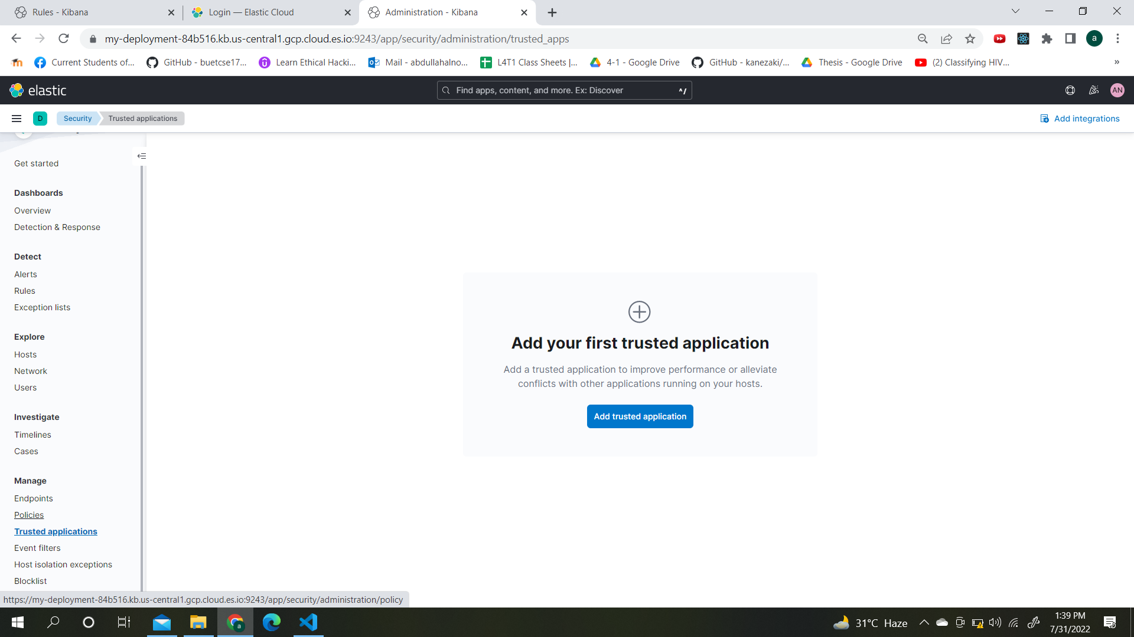
Open EDR Visualization : Add App

Slide 32
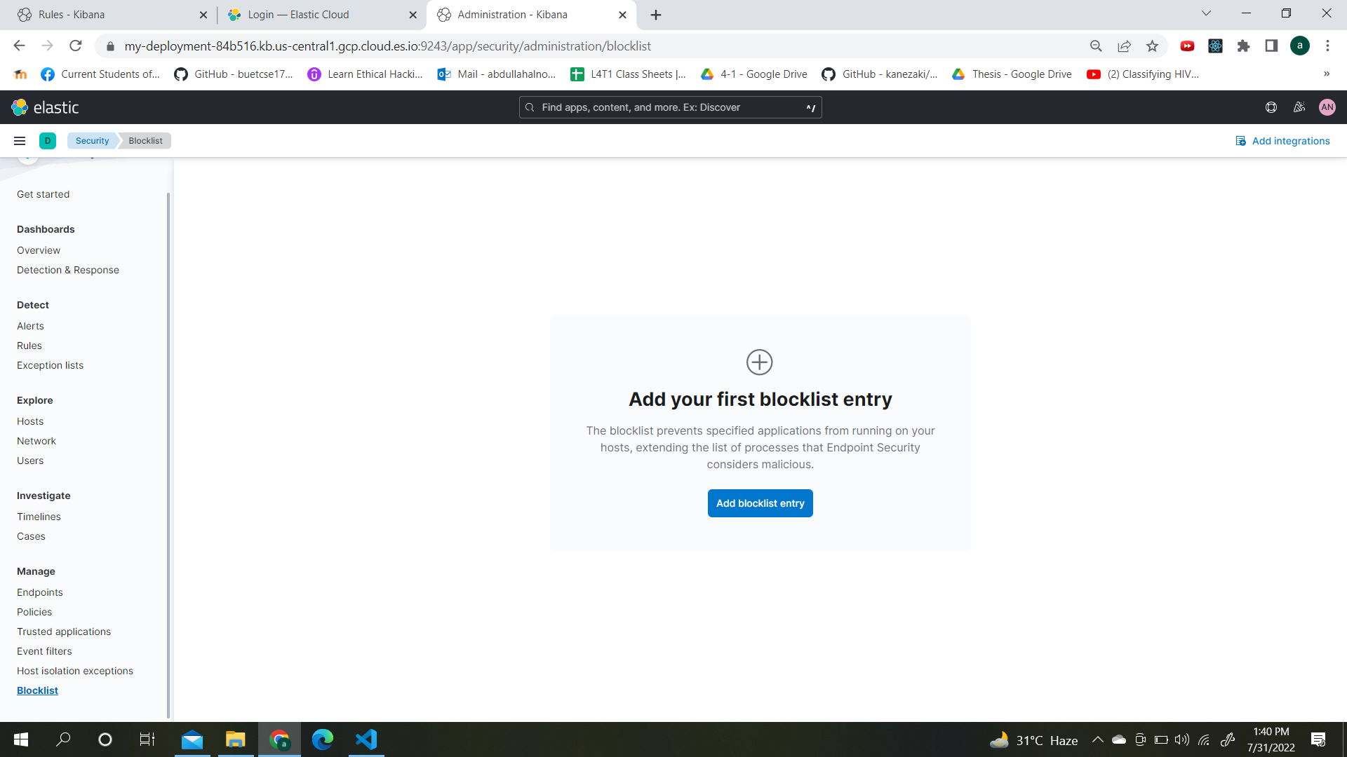
Open EDR Visualization : Blocklist

Slide 33
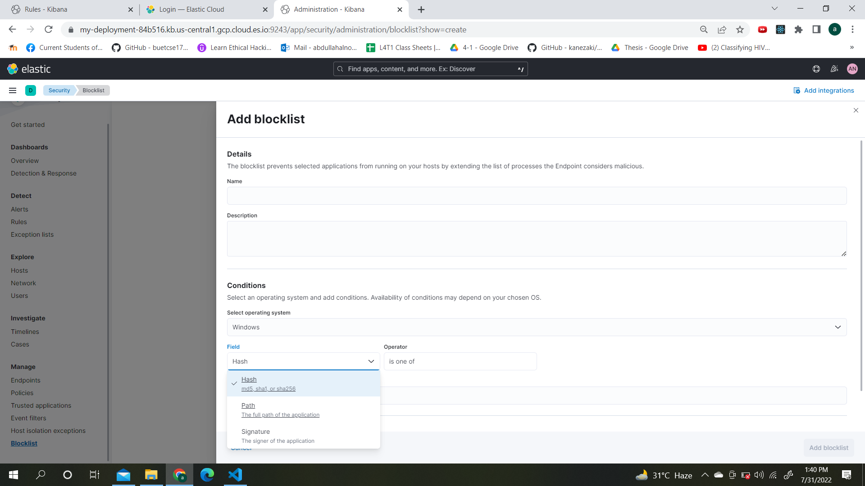
Open EDR Visualization : Blocklist(cont)

Slide 34
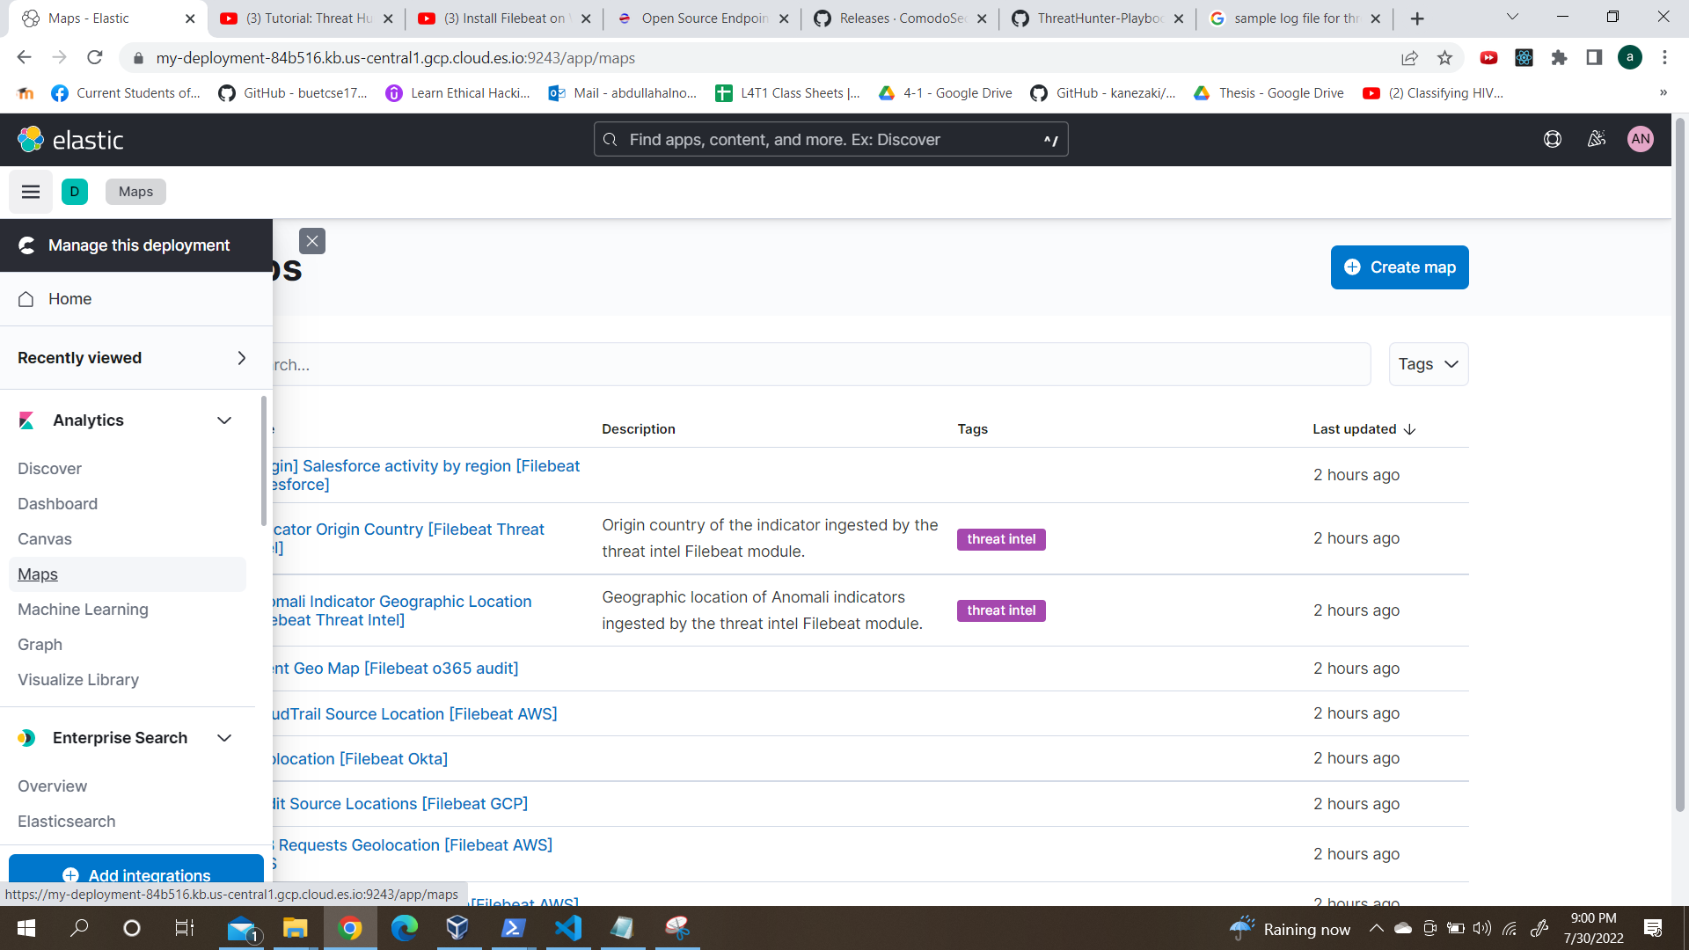
Open EDR Visualization : Maps

Slide 35
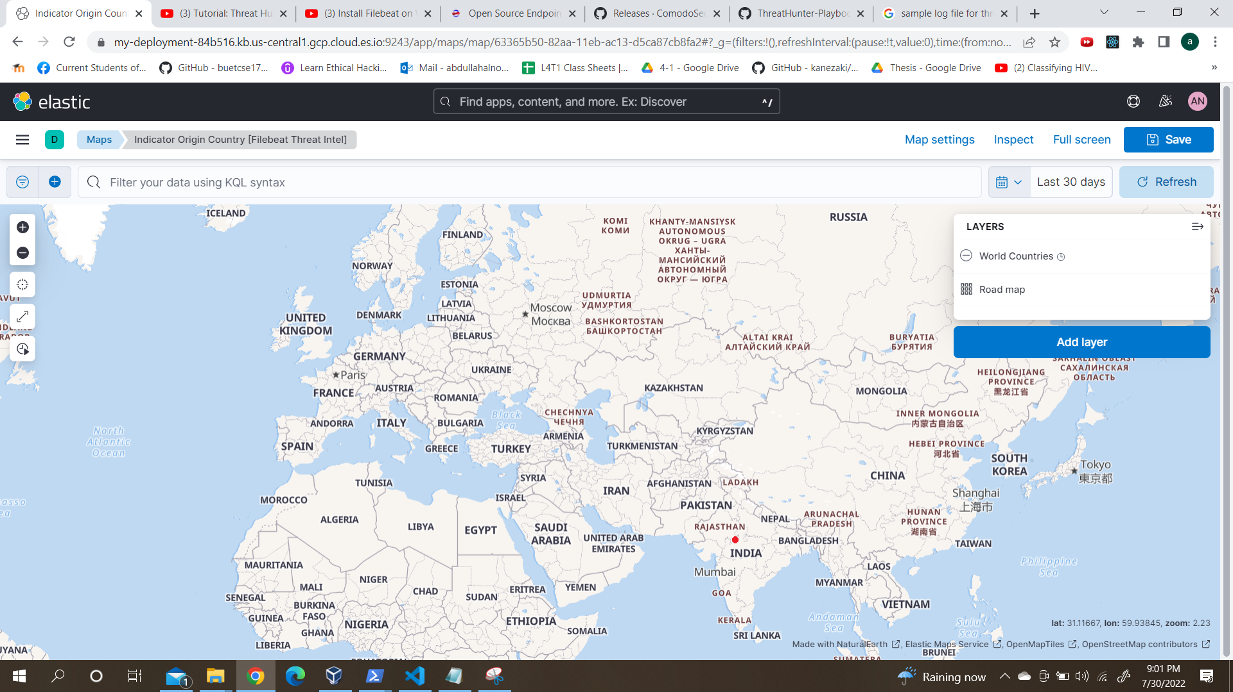
Open EDR Visualization : Maps

Slide 36
Open EDR Visualization : Maps

Slide 37
Additional Benefits
More cost-efficient
Saves time
Increased team efficiency
Go beyond detecting suspicious activities and automatically responds to threats as they arise
Continuous visibility into all activity and events at endpoints is a vital aspect of a solid security infrastructure

Slide 38
Why is Open EDR better?
After an attack, time is critical and a slow investigation may be detrimental to your company
Traditional methods require extended time for an investigation
Also limited in the depth of information and breadth of the investigation
Even if they are able to determine the impacted areas, traditional methods are typically unable to show where the attack entered and the path it took.

Slide 39
Why is Open EDR better?
Open EDR lets users know when an attack occurred
Also compiles the behavioral data to show the attack path on your network, from where it entered to the actions it took.
In addition, Open EDR compiles the data in a way that is easier for analysts to review, significantly reducing the amount of data to analyze
Thus reduces the overall time and cost of post-breach analysis

Slide 40
Thank You

